Slide 1

Big-Data Storage Concepts
Lecture4: Fundamentals of Big Data

Slide 2

Quiz
which one is the most complex type of analysis??
Descriptive analytics
B. Diagnostic analytics
C. Predictive analytics
D. all of them

Slide 3
Data acquired from external sources is often not in a format or structure that can be directly processed. To overcome these incompatibilities and prepare data for storage and processing, data wrangling is necessary.
Typically, storage is required whenever the following occurs:
• external datasets are acquired, or internal data will be used in a Big Data environment
• data is manipulated to be made amenable for data analysis
• data is processed via an ETL activity, or output is generated as a result of an analytical operation

Slide 4
Due to the need to store Big Data datasets, often in multiple copies, innovative storage strategies and technologies have been created to achieve cost-effective and highly scalable storage solutions.
In order to understand the underlying mechanisms behind Big Data storage technology, the following topics are introduced in this chapter:
• clusters
• file systems and distributed files systems
• NoSQL
• sharding
• replication
• CAP theorem
• ACID
• BASE

Slide 5
……. will continue to produce low-quality big data results.
Outdated data
Invalid data
Poorly identified data
All of the above

Slide 6
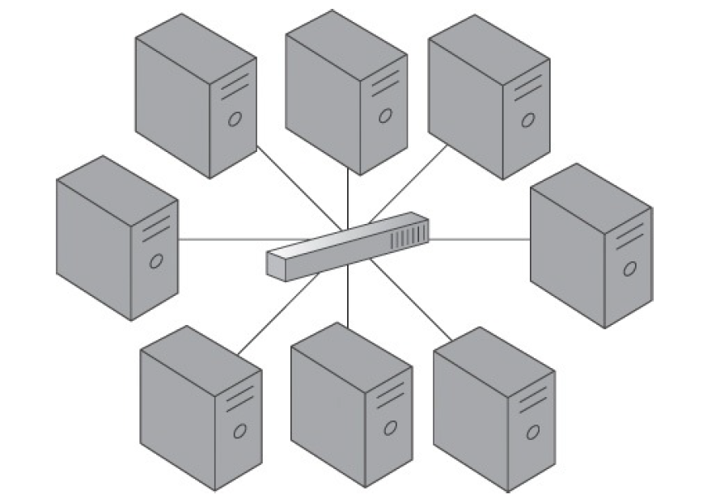
Clusters
In computing, a cluster is a tightly coupled collection of servers, or nodes. These servers usually have the same hardware specifications and are connected together via a network to work as a single unit (as shown in Figure).
Each node in the cluster has its own dedicated resources, such as memory, a processor, and a hard drive. A cluster can execute a task by splitting it into small pieces and distributing their execution onto different computers that belong to the cluster.

Slide 7
Quiz
Typically, storage is required whenever the which of the following occurs?
A. external datasets are acquired, or internal data will be used in a Big Data environment
B. data is manipulated to be made amenable for data analysis
C. Both of them
D. None of them

Slide 8
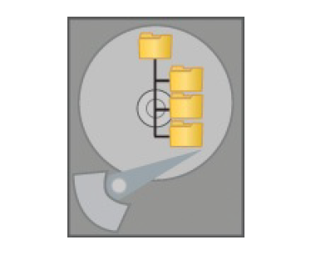
File Systems and Distributed File Systems
A file system is the method of storing and organizing data on a storage device, such as- flash drives, DVDs and hard drives.
A file is an atomic unit of storage used by the file system to store data. A file system provides a logical view of the data stored on the storage device and presents it as a tree structure of directories and files (as in Figure).
Operating systems employ file systems to store and retrieve data on behalf of applications. Each operating system provides support for one or more file systems, for example NTFS on Microsoft Windows and ext on Linux.

Slide 9
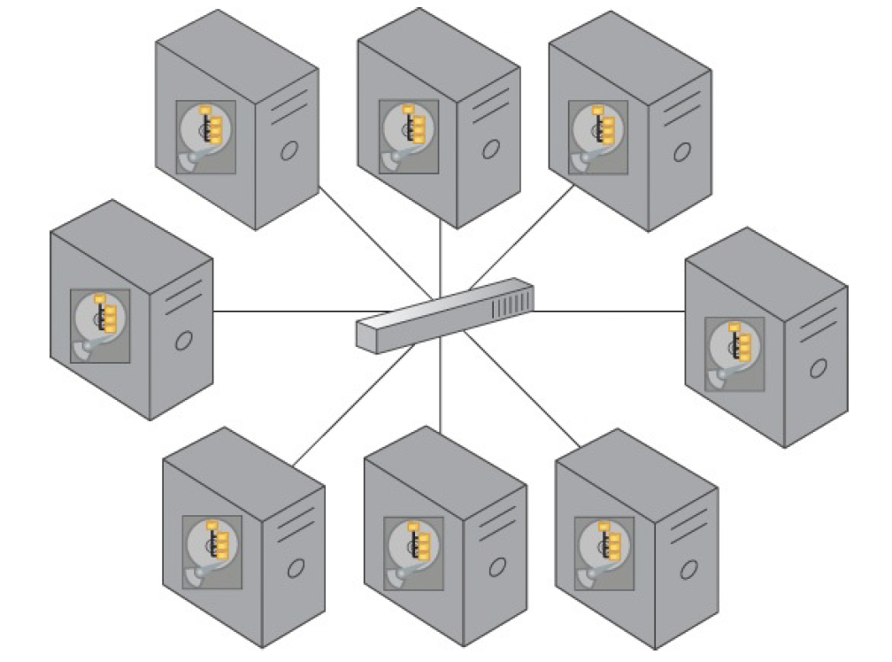
A distributed file system is a file system that can store large files spread across the nodes of a cluster.
Examples include the Google File System (GFS) and Hadoop Distributed File System (HDFS).

Slide 10
The data procurement refers ------
acquisition of data
Performing analytics
Both A and B
Securing data

Slide 11
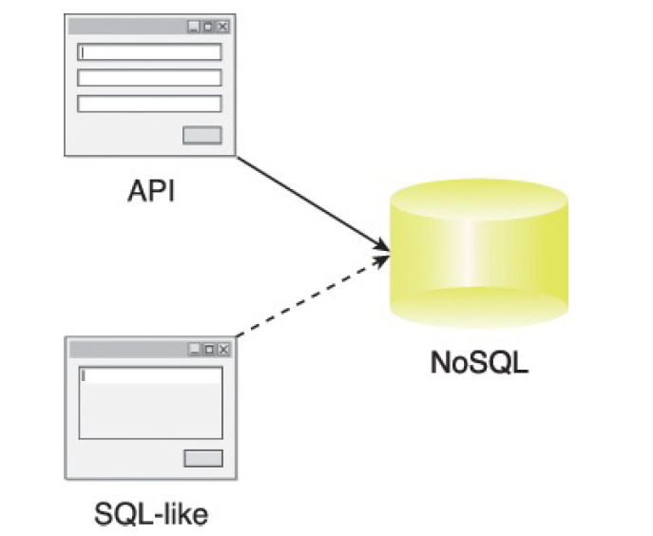
NoSQL
A Not-only SQL (NoSQL) database is a non-relational database that is highly scalable, fault-tolerant and specifically designed to house semi-structured and unstructured data.
A NoSQL database often provides an API-based query interface that can be called from within an application.
NoSQL databases also support query languages other than Structured Query Language (SQL) because SQL was designed to query structured data stored within a relational database.
As an example, a NoSQL database that is optimized to store XML files will often use XQuery as the query language. Likewise, a NoSQL database designed to store RDF data will use SPARQL to query the relationships it contains. That being said, there are some NoSQL databases that also provide an SQL-like query interface.

Slide 12
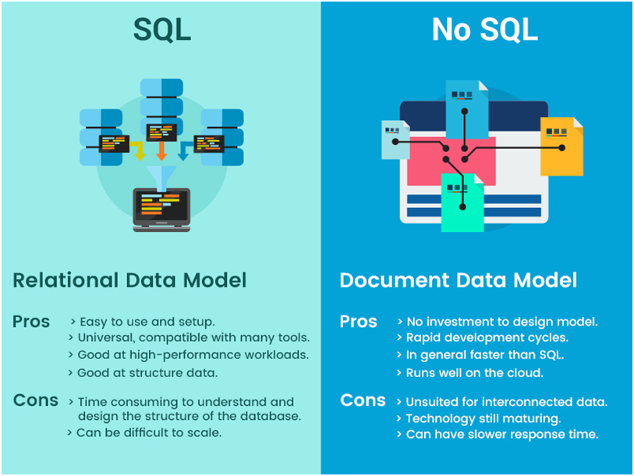

Slide 13
Non-relational database:
A non-relational database is a database that does not use the tabular schema of rows and columns found in most traditional database systems.
examples:MongoDB, Apache Cassandra, Redis, Couchbase and Apache HBase.

Slide 14
Why use a non relational database?
Non-relational databases often perform faster because a query doesn't have to view several tables in order to deliver an answer, as relational datasets often do.
Non-relational databases are therefore ideal for storing data that may be changed frequently or for applications that handle many different kinds of data.

Slide 15
Quiz
Due to the need to store Big Data datasets, often in multiple copies, innovative storage strategies and technologies have been created to achieve cost-effective and highly scalable storage solutions. Some of them are-
A. My SQL
B. Cluster
C. NoSQL
D. All

Slide 16
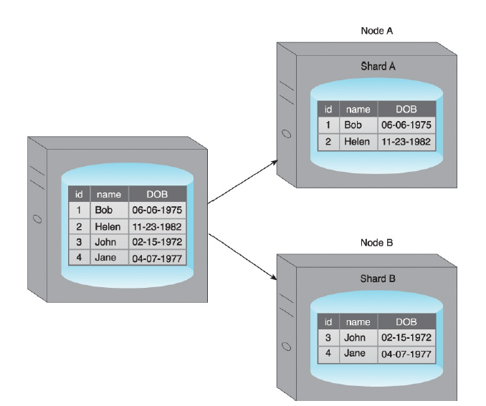
Sharding
Sharding is the process of horizontally partitioning a large dataset into a collection of smaller, more manageable datasets called shards. The shards are distributed across multiple nodes, where a node is a server or a machine
Each shard is stored on a separate node and each node is responsible for only the data stored on it. Each shard shares the same schema, and all shards collectively represent the complete dataset.
An example of sharding where a dataset is spread across Node A and Node B, resulting in Shard A and Shard B, respectively.

Slide 17
Performing analytics on datasets can reveal-------- about organizations or individuals.
Confidential information
Outdated data
Invalid data
Poorly identified data

Slide 18
Sharding is often transparent to the client, but this is not a requirement.
Sharding allows the distribution of processing loads across multiple nodes to achieve horizontal scalability.
Horizontal scaling is a method for increasing a system’s capacity by adding similar or higher capacity resources alongside existing resources.
Since each node is responsible for only a part of the whole dataset, read/write times are greatly improved.

Slide 19
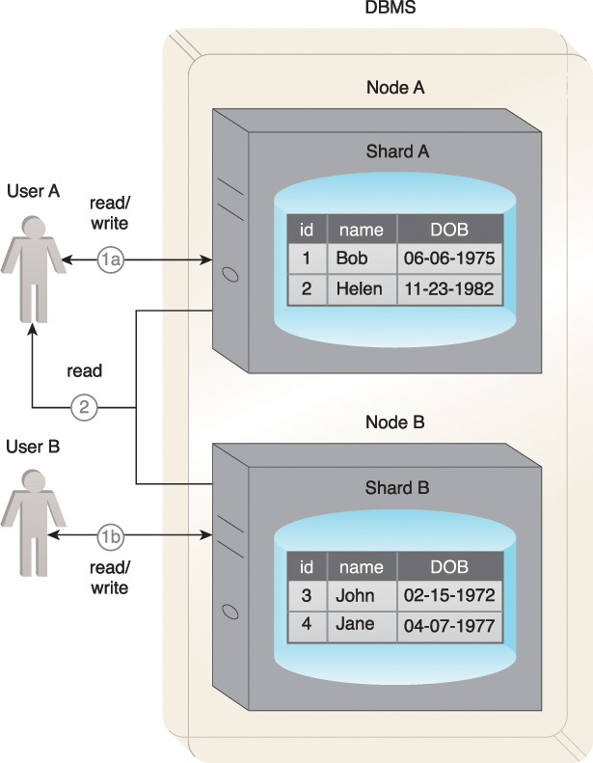
sharding works in practice:
Each shard can independently service reads and writes for the specific subset of data that it is responsible for.
2. Depending on the query, data may need to be fetched from both shards.
Figure : A sharding example where data is fetched from both Node A and Node B.

Slide 20
A benefit of sharding is that it provides partial tolerance toward failures. In case of a node failure, only data stored on that node is affected.
With regards to data partitioning, query patterns need to be taken into account so that shards themselves do not become performance bottlenecks.
For example, queries requiring data from multiple shards will impose performance penalties. Data locality keeps commonly accessed data co-located on a single shard and helps counter such performance issues.

Slide 21
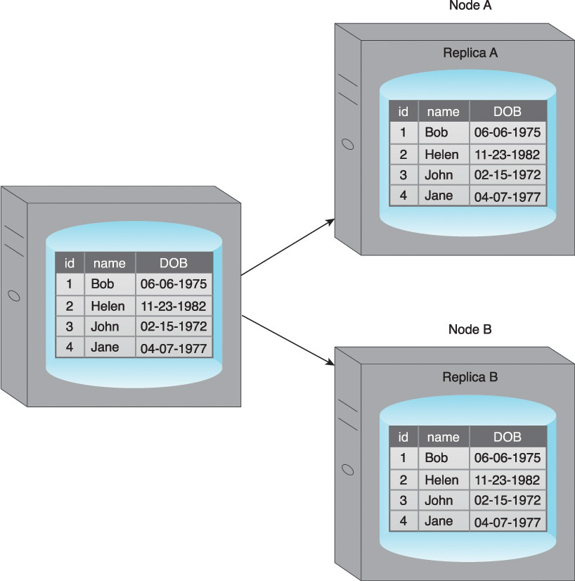
Replication
Replication stores multiple copies of a dataset, known as replicas, on multiple nodes.
Replication provides scalability and availability due to the fact that the same data is replicated on various nodes.
Fault tolerance is also achieved since data redundancy ensures that data is not lost when an individual node fails.
There are two different methods that are used to implement replication:
• master-slave
• peer-to-peer

Slide 22
Quiz
The process of horizontally partitioning a large dataset into a collection of smaller, more manageable datasets called-
Clustering
Wrangling
Sharding
Replication

Slide 23
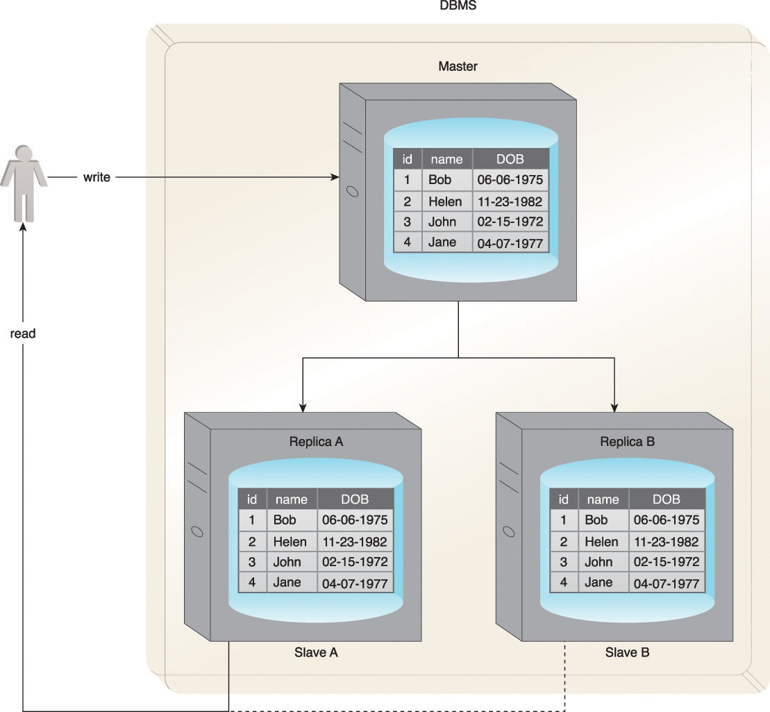
Master-Slave
During master-slave replication, nodes are arranged in a master-slave configuration, and all data is written to a master node.
Once saved, the data is replicated over to multiple slave nodes.
All external write requests, including insert, update and delete, occur on the master node,
whereas read requests can be fulfilled by any slave node.
In Figure writes are managed by the master node and data can be read from either Slave A or Slave B.

Slide 24
Master-slave replication is ideal for read intensive loads rather than write intensive loads since growing read demands can be managed by horizontal scaling to add more slave nodes.
Writes are consistent, as all writes are coordinated by the master node. The implication is that write performance will suffer as the amount of writes increases.
If the master node fails, reads are still possible via any of the slave nodes.
A slave node can be configured as a backup node for the master node.
In the event that the master node fails, writes are not supported until a master node is reestablished. The master node is either resurrected from a backup of the master node, or a new master node is chosen from the slave nodes.

Slide 25
One concern with master-slave replication is read inconsistency, which can be an issue if a slave node is read prior to an update to the master being copied to it.
To ensure read consistency, a voting system can be implemented where a read is declared consistent if the majority of the slaves contain the same version of the record.
Implementation of such a voting system requires a reliable and fast communication mechanism between the slaves.
Let us check the inconsistency through a diagram in next slide.

Slide 26
The Data Extraction lifecycle stage, is dedicated to extracting ------- it into a format.
Disparate data only
Transformation of data only
disparate data and transforming
None of the above

Slide 27
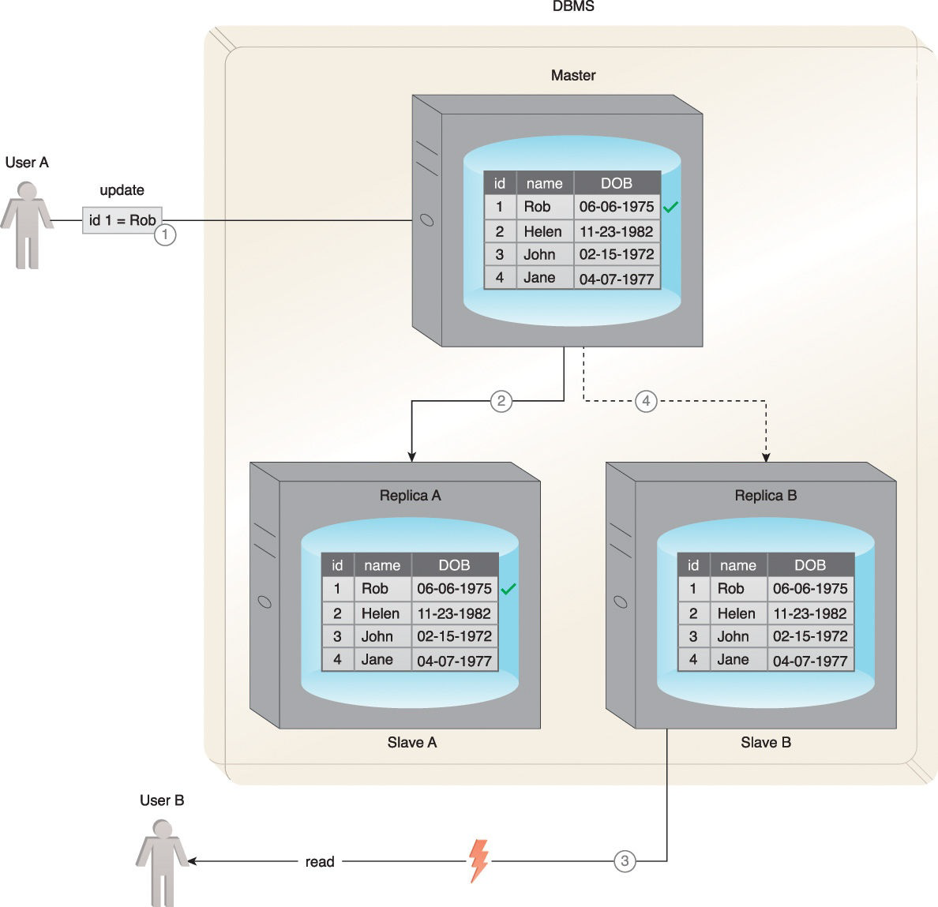
Figure illustrates a scenario where read inconsistency occurs.
1. User A updates data.
2. The data is copied over to Slave A by the Master.
3. Before the data is copied over to Slave B, User B tries to read the data from Slave B, which results in an inconsistent read.
4. The data will eventually become consistent when Slave B is updated by the Master.

Slide 28
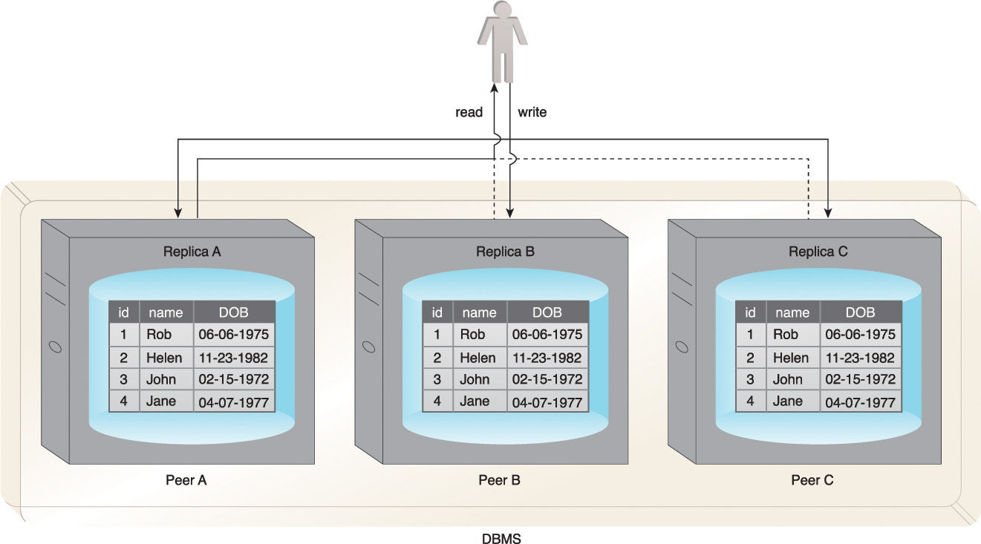
peer-to-peer replication
With peer-to-peer replication, all nodes operate at the same level. In other words, there is not a master-slave relationship between the nodes. Each node, known as a peer, is equally capable of handling reads and writes.
Figure: Writes are copied to Peers A, B and C simultaneously. Data is read from Peer A, but it can also be read from Peers B or C.

Slide 29
Peer-to-peer replication is prone to write inconsistencies that occur as a result of a simultaneous update of the same data across multiple peers.
This can be addressed by implementing either a pessimistic or optimistic concurrency strategy.
• Pessimistic concurrency is a proactive strategy that prevents inconsistency. It uses locking to ensure that only one update to a record can occur at a time. However, this is detrimental to availability since the database record being updated remains unavailable until all locks are released.
• Optimistic concurrency is a reactive strategy that does not use locking. Instead, it allows inconsistency to occur with knowledge that eventually consistency will be achieved after all updates have propagated.

Slide 30
With optimistic concurrency, peers may remain inconsistent for some period of time before attaining consistency. However, the database remains available as no locking is involved. Like master-slave replication, reads can be inconsistent during the time period when some of the peers have completed their updates while others perform their updates. However, reads eventually become consistent when the updates have been executed on all peers.
To ensure read consistency, a voting system can be implemented where a read is declared consistent if the majority of the peers contain the same version of the record. As previously indicated, implementation of such a voting system requires a reliable and fast communication mechanism between the peers.

Slide 31
Which of the following is TRUE about Data validation and cleansing stage?
removing any known invalid data
Disparate data only
Correlations only
identifying the datasets

Slide 32
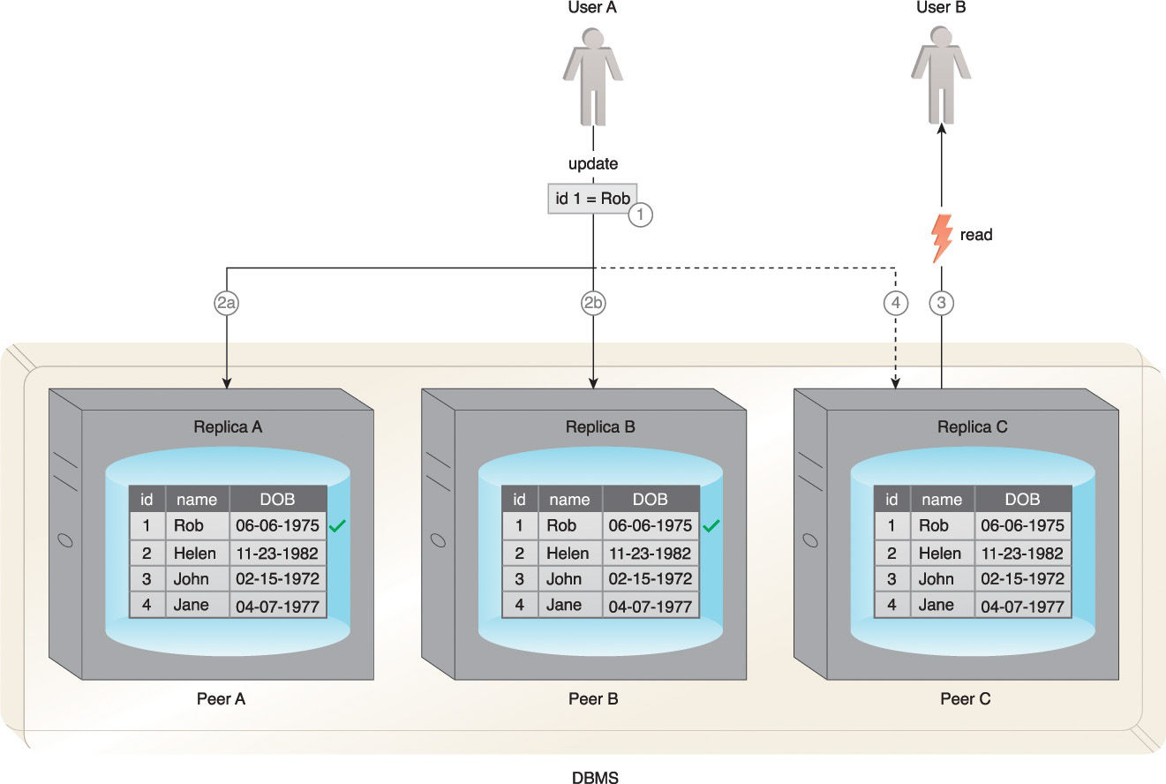
a scenario where an inconsistent read occurs.
User A updates data.
2.
a. The data is copied over to Peer A.
b. The data is copied over to Peer B.
3. Before the data is copied over to Peer C, User B tries to read the data from Peer C, resulting in an inconsistent read.
4. The data will eventually be updated on Peer C, and the database will once again become consistent.

Slide 33
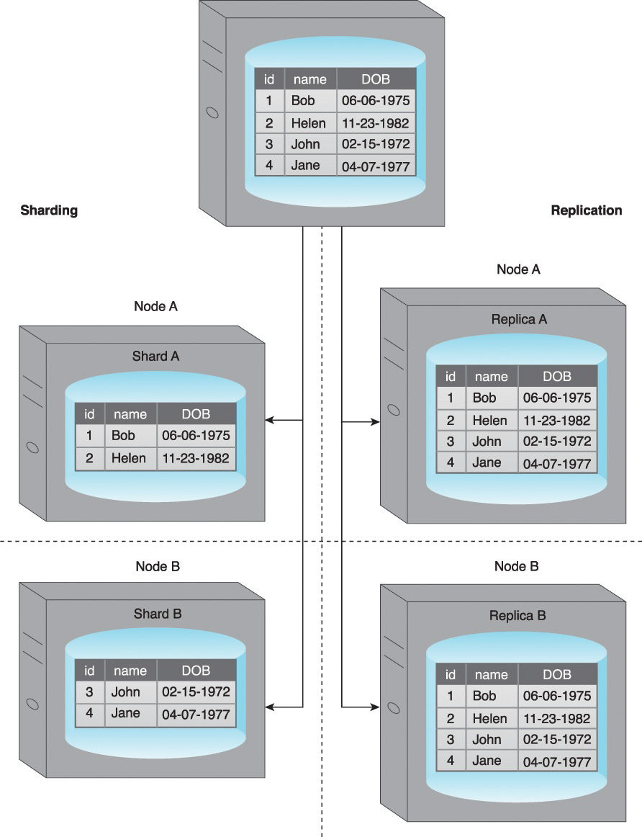
Sharding and Replication
To improve on the limited fault tolerance offered by sharding, while additionally benefiting from the increased availability and scalability of replication, both sharding and replication can be combined
Let us see the following combinations:
• sharding and master-slave replication
• sharding and peer-to-peer replication

Slide 34
Combining Sharding and Master-Slave Replication
When sharding is combined with master-slave replication, multiple shards become slaves of a single master, and the master itself is a shard. Although this results in multiple masters, a single slave-shard can only be managed by a single master-shard.
Write consistency is maintained by the master-shard. However, if the master-shard becomes non-operational or a network outage occurs, fault tolerance with regards to write operations is impacted. Replicas of shards are kept on multiple slave nodes to provide scalability and fault tolerance for read operations.

Slide 35
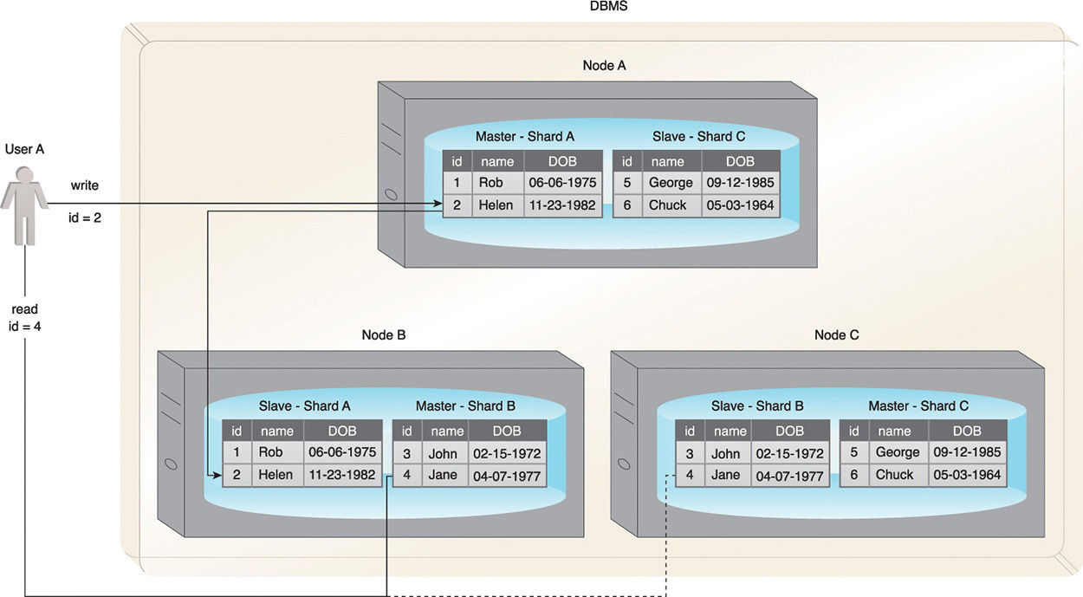
An example that shows the combination of sharding and master-slave replication

Slide 36
Which of the following is TRUE about Data Analysis stage?
It involves one or more types of analytics
removing any known invalid data
integrating multiple datasets
None of the above

Slide 37
Explanation of the figure
• Each node acts both as a master and a slave for different shards.
• Writes (id = 2) to Shard A are regulated by Node A, as it is the master for Shard A.
• Node A replicates data (id = 2) to Node B, which is a slave for Shard A.
• Reads (id = 4) can be served directly by either Node B or Node C as they each contain Shard B.

Slide 38
Combining Sharding and Peer-to-Peer Replication
When combining sharding with peer-to-peer replication, each shard is replicated to multiple peers, and each peer is only responsible for a subset of the overall dataset.
Collectively, this helps achieve increased scalability and fault tolerance. As there is no master involved, there is no single point of failure and fault-tolerance for both read and write operations is supported.

Slide 39
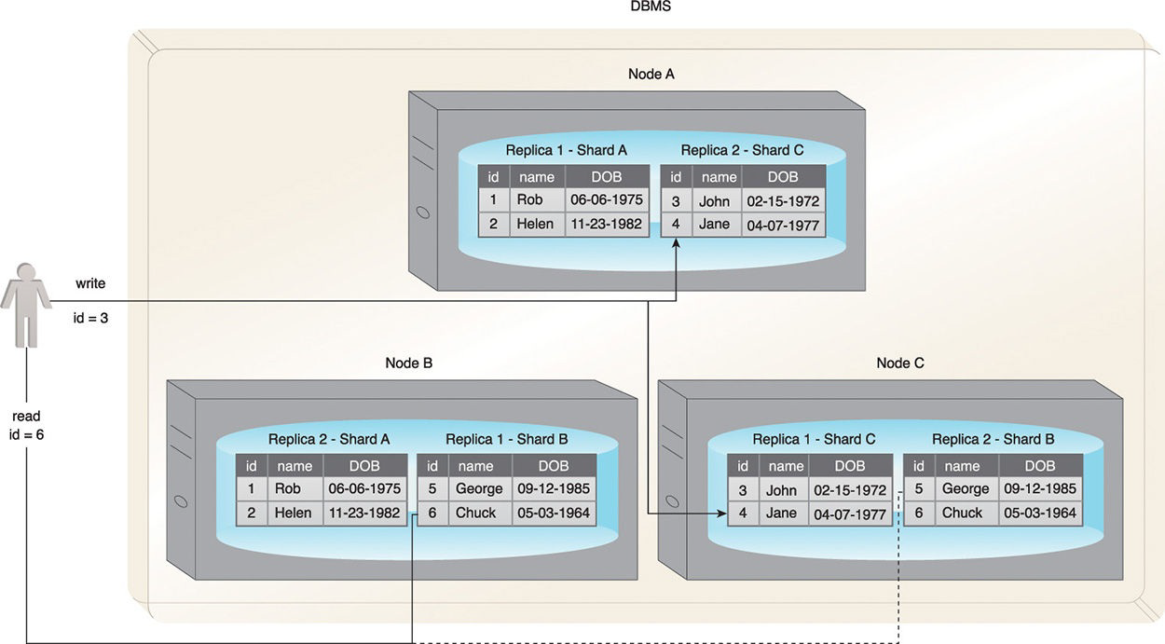
An example of the combination of sharding and peer-to-peer replication.

Slide 40
Explanation of the figure
• Each node contains replicas of two different shards.
• Writes (id = 3) are replicated to both Node A and Node C (Peers) as they are responsible for Shard C.
• Reads (id = 6) can be served by either Node B or Node C as they each contain Shard B.

Slide 41
Quiz
Horizontal scaling is a method for
A. Shrinking a system’s capacity by adding similar or higher capacity resources alongside existing resources.
B. Increasing a system’s capacity by adding similar or higher capacity resources alongside existing resources.
C. Shrinking a system’s capacity by removing similar or higher capacity resources alongside existing resources.
D. Increasing a system’s capacity by removing similar or higher capacity resources alongside existing resources.

Slide 42
CAP Theorem
The Consistency, Availability, and Partition tolerance (CAP) theorem, also known as Brewer’s theorem, expresses a triple constraint related to distributed database systems.
It states that a distributed database system, running on a cluster, can only provide two of those three properties:
1. Consistency: A read from any node results in the same data across multiple nodes
2. Availability: A read/write request will always be acknowledged in the form of a success or a failure
3. Partition tolerance – The database system can tolerate communication outages that split the cluster into multiple silos and can still service read/write requests

Slide 43
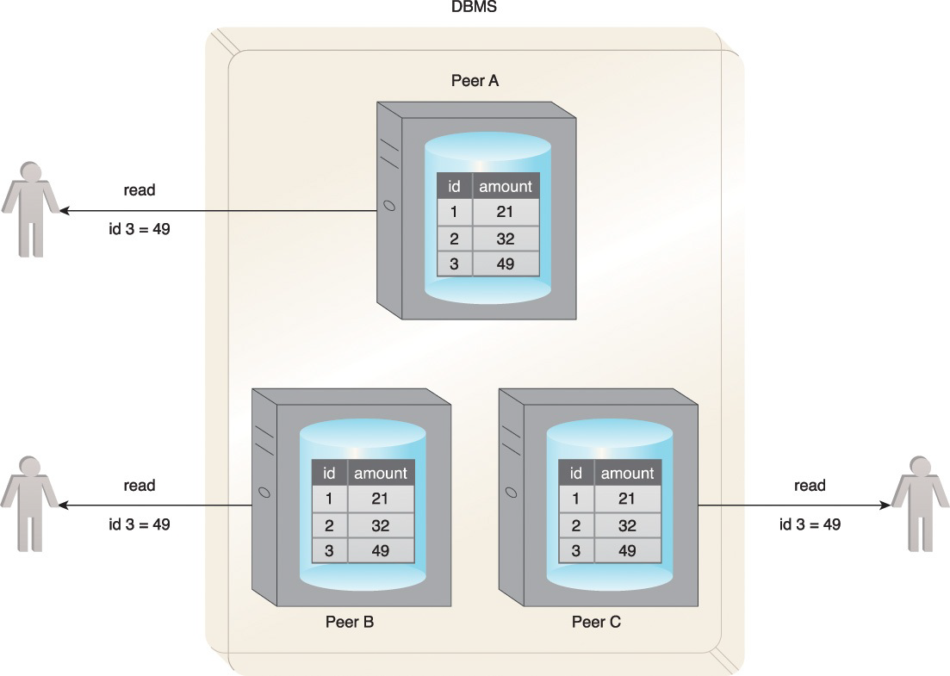
Consistency: all three users get the same value for the amount column even though three different nodes are serving the record.

Slide 44
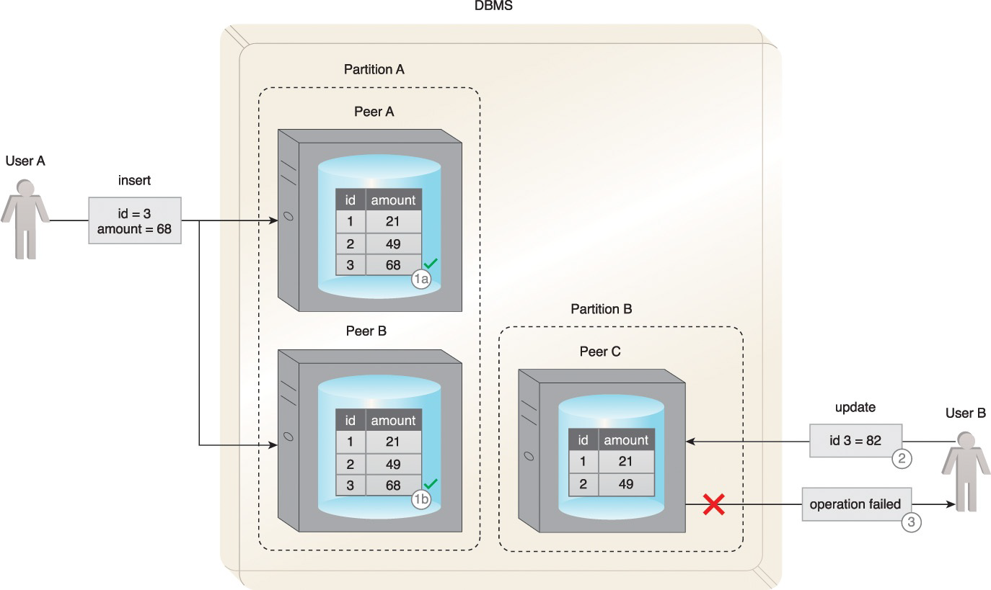
Availability and partition tolerance: in the event of a communication failure, requests from both users are still serviced (1, 2 ). However, with User B, the update fails as the record with id = 3 has not been copied over to Peer C. The user is duly notified (3) that the update has failed.

Slide 45
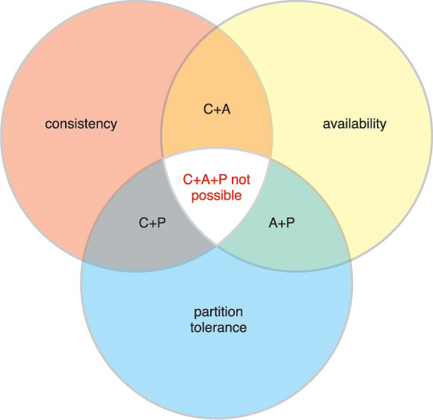
A Venn diagram summarizing the CAP theorem
If consistency (C) and availability (A) are required, available nodes need to communicate to ensure consistency (C). Therefore, partition tolerance (P) is not possible.
If consistency (C) and partition tolerance (P) are required, nodes cannot remain available (A) as the nodes will become unavailable while achieving a state of consistency (C).
If availability (A) and partition tolerance (P) are required, then consistency (C) is not possible because of the data communication requirement between the nodes. So, the database can remain available (A) but with inconsistent results.
In a distributed database, scalability and fault tolerance can be improved through additional nodes, although this challenges consistency (C). The addition of nodes can also cause availability (A) to suffer due to the latency caused by increased communication between nodes.
Distributed database systems cannot be 100% partition tolerant (P). Although communication outages are rare and temporary, partition tolerance (P) must always be supported by a distributed database; therefore, CAP is generally a choice between choosing either C+P or A+P. The requirements of the system will dictate which is chosen.

Slide 46
ACID
It’s a traditional Transaction management system for RDBMS.
For a transaction to be Good, it should follow theb ACID property.
ACID is acronym for the following Concepts:
Automacity: ensures that all operations will always succeed or fail completely. In other words, there are no partial transactions.
Consistancy:ensures that the database will always remain in a consistent state. ensures that the database will always remain in a consistent state
Isolation: ensures that the results of a transaction are not visible to other operations until it is complete.
Durability: ensures that the results of an operation are permanent. In other words, once a transaction has been committed, it cannot be rolled back. This is irrespective of any system failure.

Slide 47
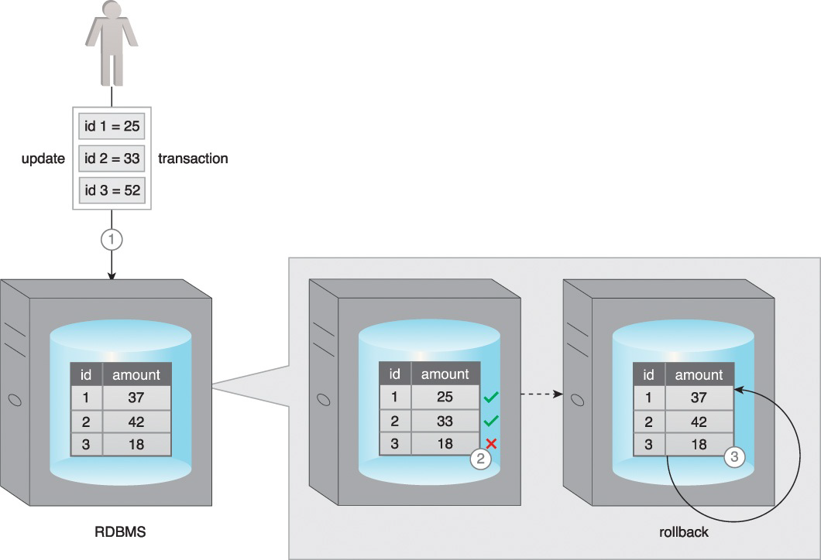
Automacity
1. A user attempts to update three records as a part of a transaction.
2. Two records are successfully updated before the occurrence of an error.
3. As a result, the database roll backs any partial effects of the transaction and puts thesystem back to its prior state.

Slide 48
Quiz
One major issue with Peer-to-peer replication is, it is prone to
write inconsistencies
Read Inconsistency
Voting
All of them

Slide 49
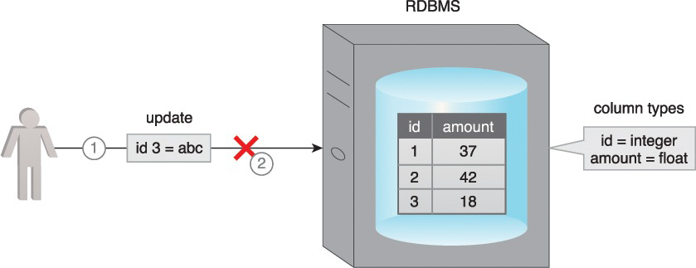
Consistancy
1. A user attempts to update the amount column of the table that is of type float with a varchar value.
2. The database applies its validation check and rejects this update because the value violates the constraint checks for the amount column.

Slide 50
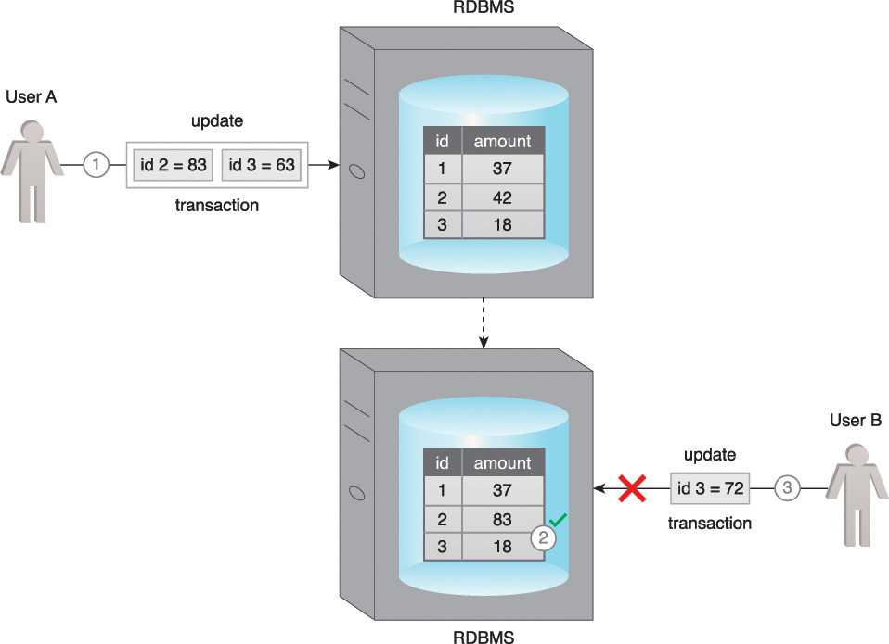
Isolation
1. User A attempts to update two records as part of a transaction.
2. The database successfully updates the first record.
3. However, before it can update the second record, User B attempts to update the same record. The database does not permit User B’s update until User A’s update succeeds or fails in full. This occurs because the record with id3 is locked by the database until the transaction is complete.

Slide 51
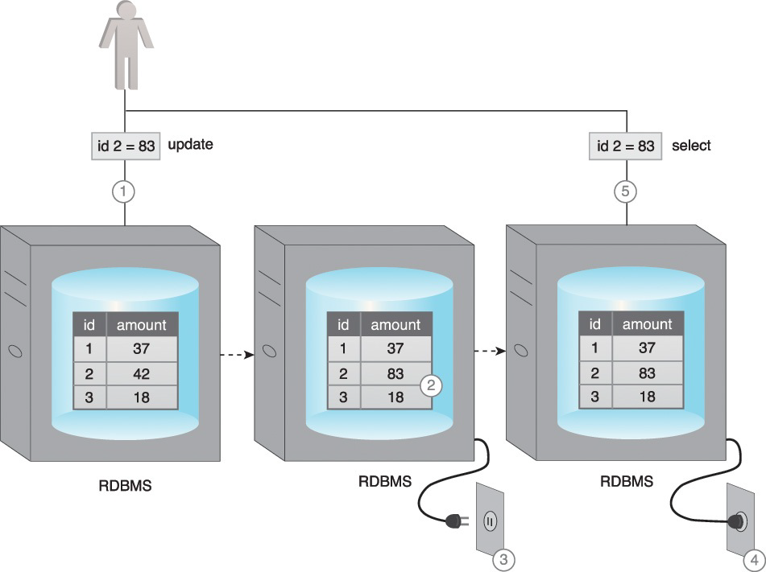
Durability
1. A user updates a record as part of a transaction.
2. The database successfully updates the record.
3. Right after this update, a power failure occurs. The database maintains its state while there is no power.
4. The power is resumed.
5. The database serves the record as per last update when requested by the user.

Slide 52
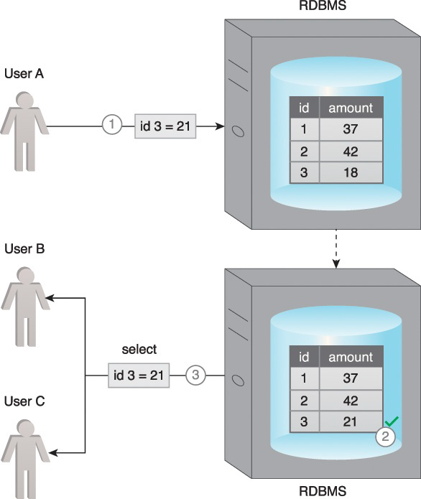
The ACID principle results in consistent database behavior
1. User A attempts to update a record as part of a transaction.
2. The database validates the value and the update is successfully applied.
3. After the successful completion of the transaction, when Users B and C request thesame record, the database provides the updated value to both the users.

Slide 53
BASE
BASE is a database design principle based on the CAP theorem and leveraged by database systems that use distributed technology.
BASE stands for:
• basically available
• soft state
• eventual consistency
When a database supports BASE, it favors availability over consistency. In other words, the database is A+P from a CAP perspective. In essence, BASE leverages optimistic concurrency by relaxing the strong consistency constraints mandated by the ACID properties.
If a database is “basically available,” that database will always acknowledge a client’s request, either in the form of the requested data or a success/failure notification.

Slide 54
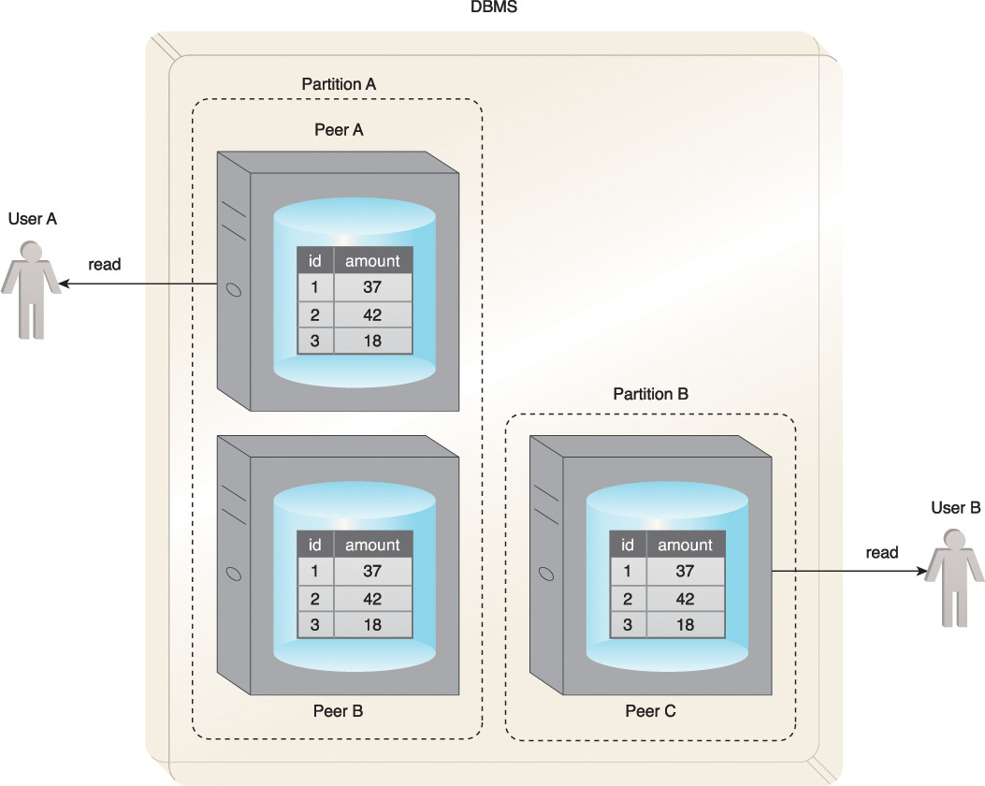
User A and User B receive data despite the database being partitioned by a network failure.

Slide 55
Soft state means that a database may be in an inconsistent state when data is read; thus, the results may change if the same data is requested again.
This is because the data could be updated for consistency, even though no user has written to the database between the two reads.
This property is closely related to eventual consistency.

Slide 56
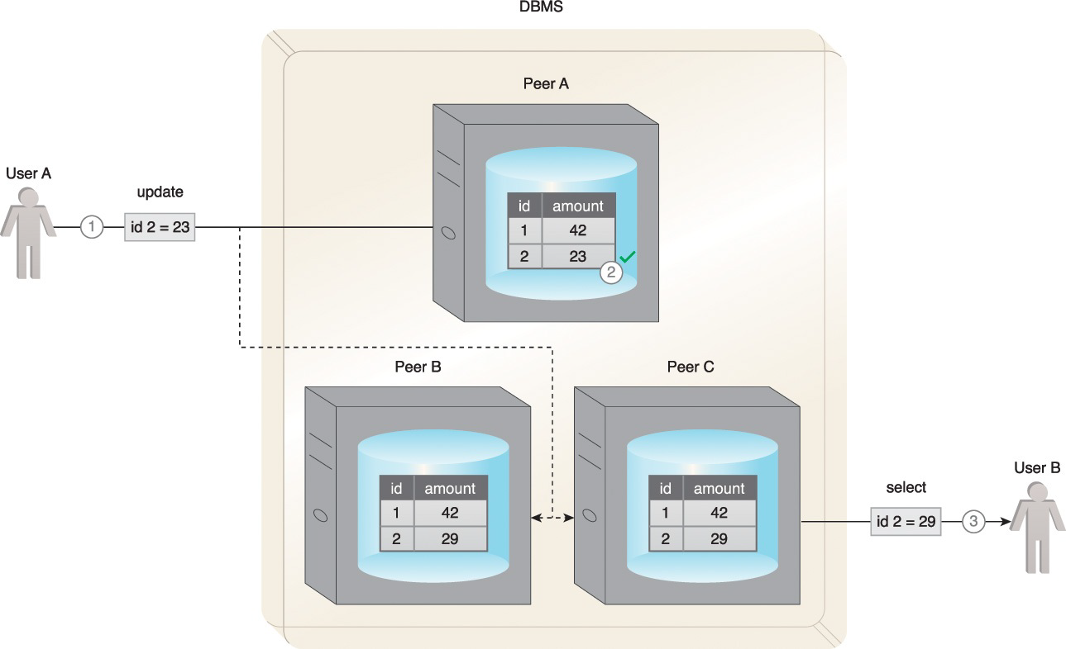
An example of the soft state property of BASE is shown here.
1. User A updates a record on Peer A.
2. Before the other peers are updated, User B requests the same record from Peer C.
3. The database is now in a soft state, and stale data is returned to User B.

Slide 57
Eventual consistency is the state in which reads by different clients, immediately following a write to the database, may not return consistent results.
The database only attains consistency once the changes have been propagated to all nodes.
While the database is in the process of attaining the state of eventual consistency, it will be in a soft state.

Slide 58
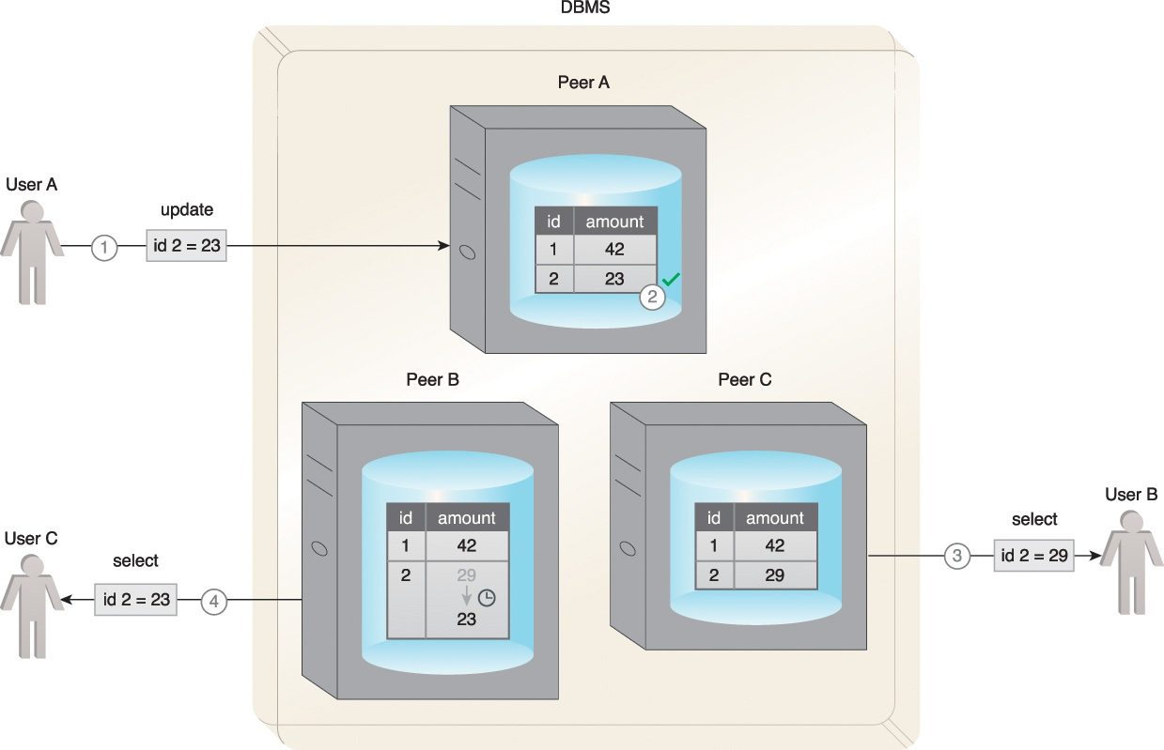
An example of the eventual consistency property of BASE.
1. User A updates a record.
2. The record only gets updated at Peer A, but before the other peers can be updated, User B requests the same record.
3. The database is now in a soft state. Stale data is returned to User B from Peer C.
4. However, the consistency is eventually attained, and User C gets the correct value.

Slide 59
BASE emphasizes availability over immediate consistency, in contrast to ACID, which ensures immediate consistency at the expense of availability due to record locking.
This soft approach toward consistency allows BASE compliant databases to serve multiple clients without any latency albeit serving inconsistent results.
However, BASE-compliant databases are not useful for transactional systems where lack of consistency is a concern.

Slide 60
Quiz
BASE is a database design principle, in the soft state the database is allowed to be in inconsistence state
True
B. False

Slide 61


